Slide 1
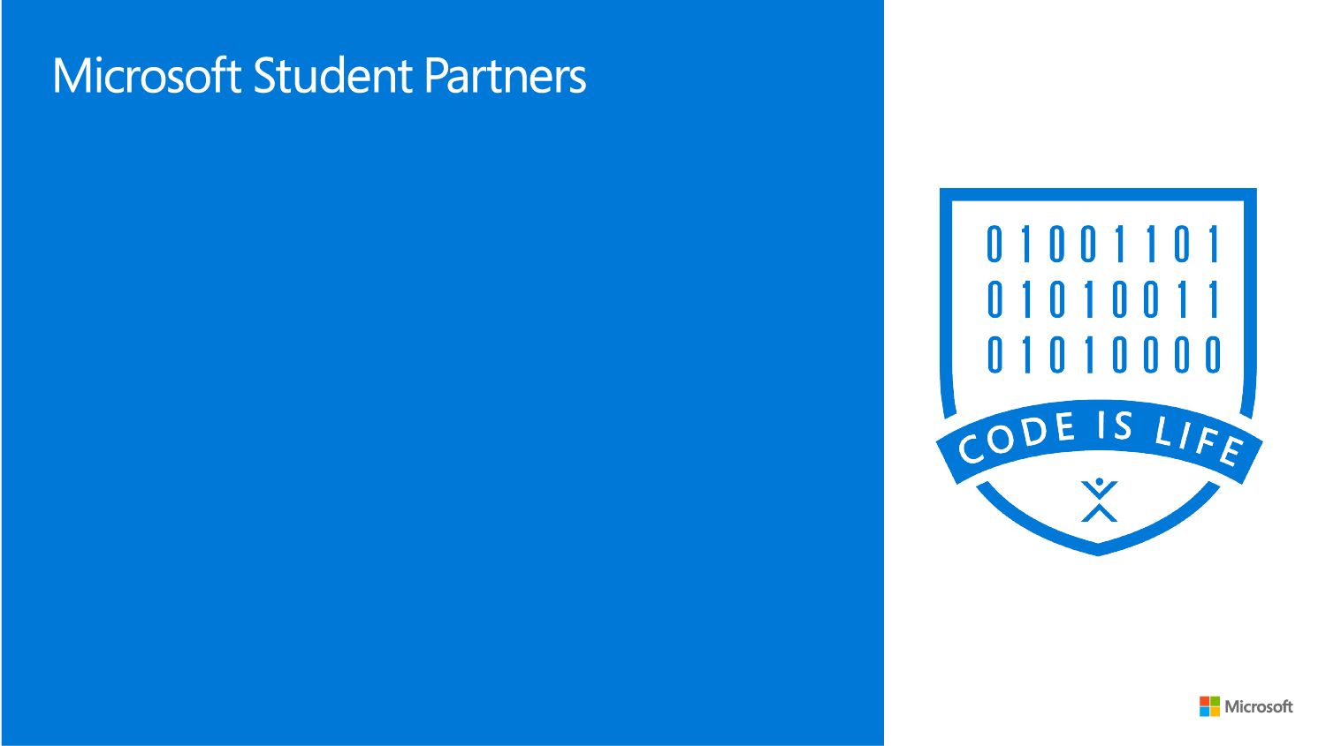
Distributed Networking & AI-NLP
Please take a seat, we’ll start shortly

Slide 2

Hola, This is Soumyadip
Open Source Contributor
Cloud & Microservices Developer
Distributed Mobile Networking Researcher
Teaching Assistant at Multiple Organizations

Slide 3
Today’s Agenda
What is Git & GitHub?
What is Distributed Networking?
Why we need Peer to Peer networking?
What are the aspects of AI?
What is Natural Language Processing?
Some implementation of Natural Language Processing
What is the future of Distributed networking in future?
Can we merge Distributed Networking with AI & NLP?
(Think and Again Think)

Slide 4

What is ?
Notes:
So what would you do with it? We are here to help you answer that question
Lets start with a brief introduction about Technobuzz.
It’s a workshop series to help you shape your career and decide a career path. It will also help you understand how technology can help your business.
We will first cover an introduction to a field of technology which is for today, Cloud Computing, and discuss career opportunities available in the field and we’ll provide you with the learning resources for you to move forward after this session. We will have a hands-on session tomorrow for more concrete understanding of what you learn today.
Enough of Technobuzz, now lets dive into cloud computing

Slide 5
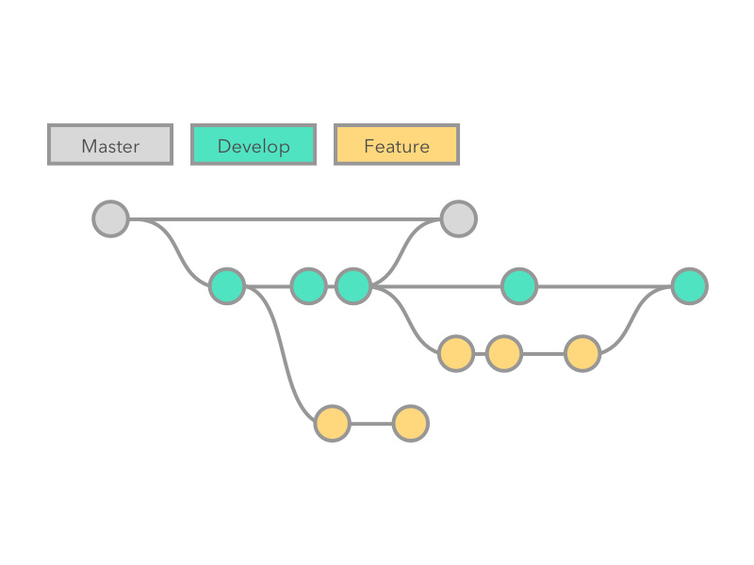
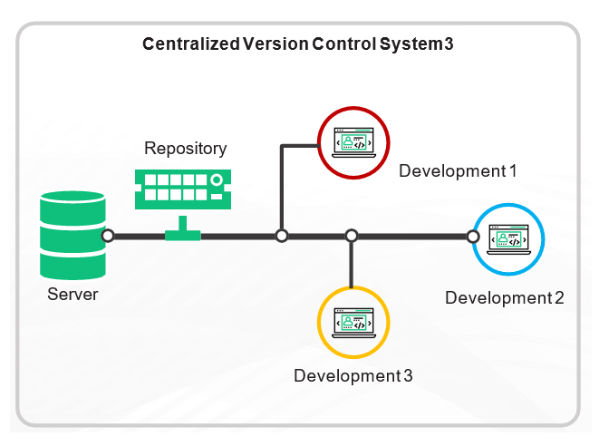

What is Version Control?
A version control system allows users to keep track of the changes in software development projects and enable them to collaborate on those projects. Using it, the developers can work together on code and separate their tasks through branches.
Examples : GIT, CVS, SVN, Bitkeeper etc.

Slide 6

Types Of Version Controlling Systems
Local Version Controlling
Centralized Version Controlling
Distributed Version Controlling

Slide 7
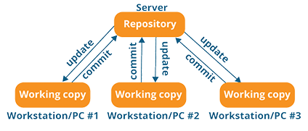
Centralized Version Controlling Systems

Slide 8
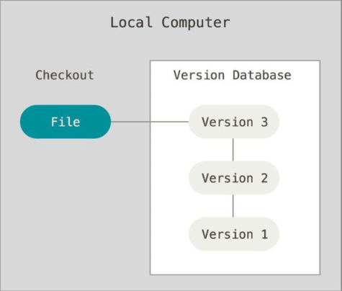
Local Version Controlling Systems

Slide 9
Contributor vs Collaborator
Contributor: A contributor is someone from the outside not on the core development team of the project that wants to contribute some changes to a project.
Collaborator: A collaborator is someone on the core development team of the project and has commit access to the main repository of the project.

Slide 10
What’s Next?
Do some Hands-On

Slide 11
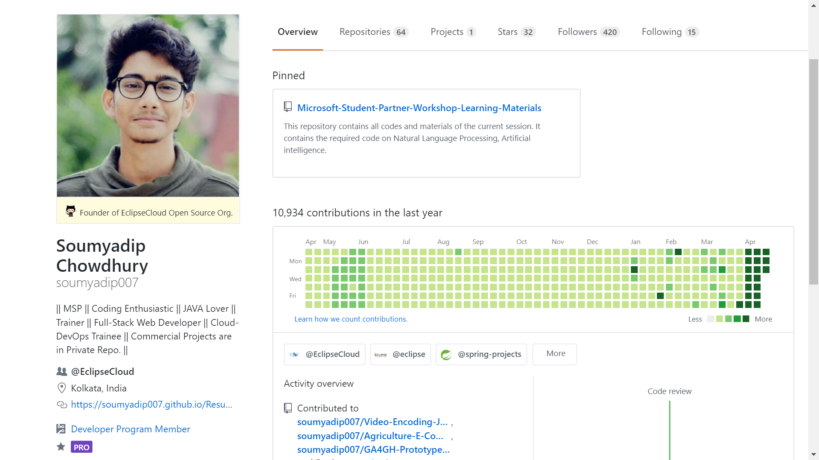
Go to Github.com

Slide 12
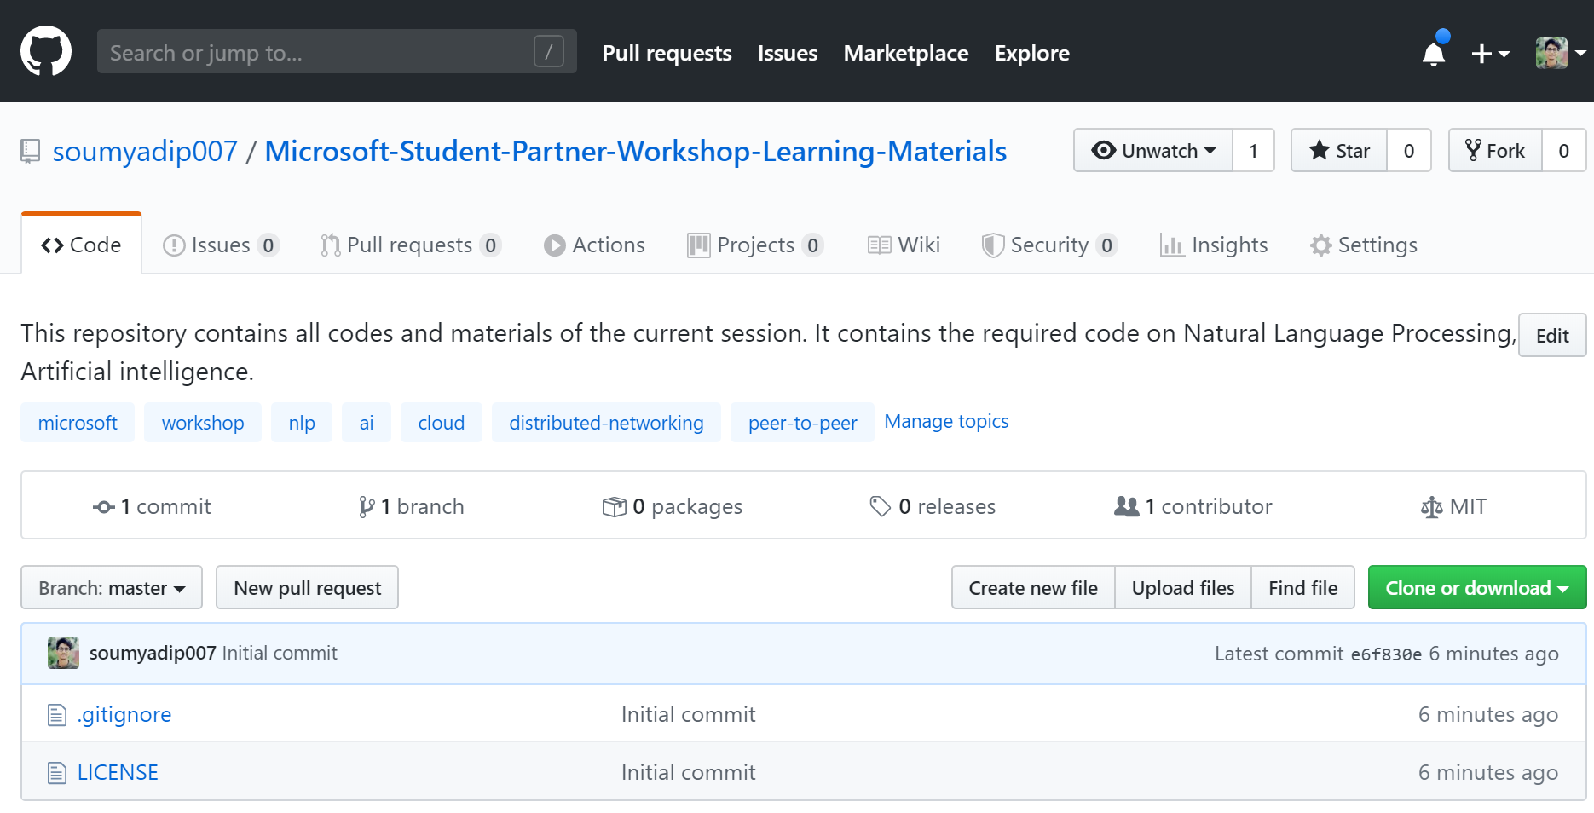
Fork the Repository and Get the Codes ☺

Slide 13
Got the Codes in your account?
Notes:
Let’s hear it from you guys first. What do you think is cloud computing?

Slide 14
What is distributed networking?
Notes:
Let’s hear it from you guys first. What do you think is cloud computing?

Slide 15
So you think about Distributed Networking?
Notes:
Let’s hear it from you guys first. What do you think is cloud computing?

Slide 16
What is Distributed Networking?
Distributed networking, used in distributed computing, is the network system over which computer programming, software, and its data are spread out across more than one computer, but communicate complex messages through their nodes (computers), and are dependent upon each other.
Notes:
Tell full definition
Quite a mouthful right?

Slide 17
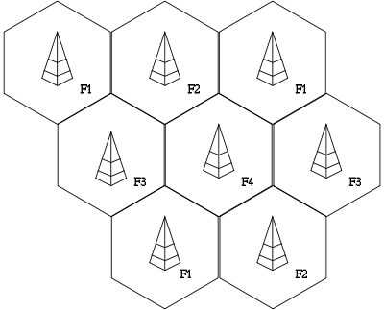
How do mobile phones work?
Cellular base stations (antennas + cpu) with hexagonal cells

Slide 18
Channel assignments
Each base station uses a set of
“channels” (e.g. frequencies) to communicate with mobile nodes in its cell
Usually adjacent cells do not use same channel
– To avoid interference

Slide 19
Wireless Networks
♣
Need: Access computing and communication services, on the move
♣
Infrastructure­based Networks
– traditional cellular systems (base station infrastructure)
♣
Wireless LANs
–
–
–
Infrared (IrDA) or radio links (Wavelan)
very flexible within the reception area; ad­hoc networks possible low bandwidth compared to wired networks (1­10 Mbit/s)
♣
Ad hoc Networks
–
–
useful when infrastructure not available, impractical, or expensive military applications, rescue, home networking

Slide 20
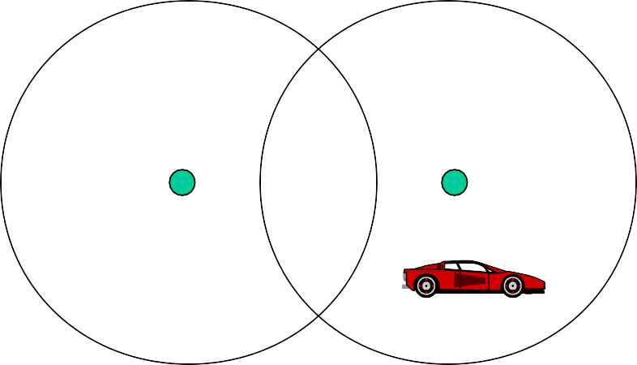
Cellular Wireless
Single hop wireless connectivity to the wired world
Space divided into cells
A base station is responsible to communicate with hosts in its cell
Mobile hosts can change cells while communicating
Hand­off occurs when a mobile host starts communicating via a new base station

Slide 21





Multi­Hop Wireless
♣ May need to traverse multiple links to reach destination
♣ Mobility causes route changes

Slide 22
Mobile Ad Hoc Networks
Host movement frequent
Topology change frequent
B
A
A
B
No cellular infrastructure. Multi­hop wireless links.
Data must be routed via intermediate nodes.

Slide 23
Why Ad Hoc Networks ?
Setting up of fixed access points and backbone infrastructure is not always viable
Infrastructure may not be present in a disaster area or war zone
Infrastructure may not be practical for short­range radios; Bluetooth (range ~ 10m)
Ad hoc networks:
Do not need backbone infrastructure support
Are easy to deploy
Useful when infrastructure is absent, destroyed or impractical

Slide 24
Many Applications
Personal area networking
cell phone, laptop, ear phone, wrist watch
Military environments
soldiers, tanks, planes
Civilian environments
taxi cab network
meeting rooms
sports stadiums
boats, small aircraft
Emergency operations
search­and­rescue
policing and fire fighting

Slide 25
Challenges in Mobile Environments
•
Limitations of the Wireless Network
•
•
•
packet loss due to transmission errors variable capacity links
frequent disconnections/partitions limited communication bandwidth Broadcast nature of the communications
•
Limitations Imposed by Mobility
•
•
dynamically changing topologies/routes
lack of mobility awareness by system/applications
•
Limitations of the Mobile Computer
•
•
short battery lifetime limited capacities

Slide 26
Can you relate this with Covid-19 Pandemic?

Slide 27
AI really Exists ?
Notes:
Let’s hear it from you guys first. What do you think is cloud computing?

Slide 28
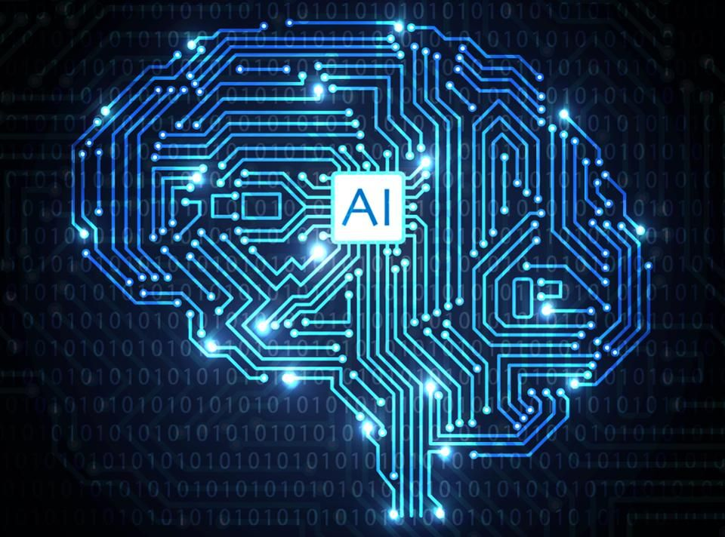
What is Artificial Intelligence ?
Artificial Intelligence (AI) is the branch of computer sciences that emphasizes the development of intelligence machines, thinking and working like humans. For example, speech recognition, problem-solving, learning and planning

Slide 29
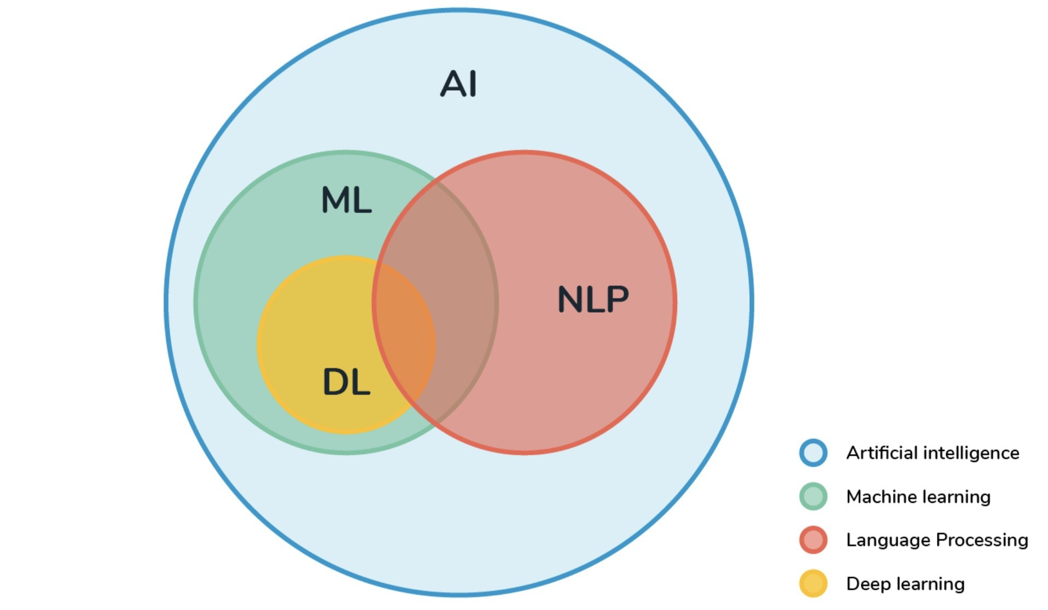
AI ?

Slide 30
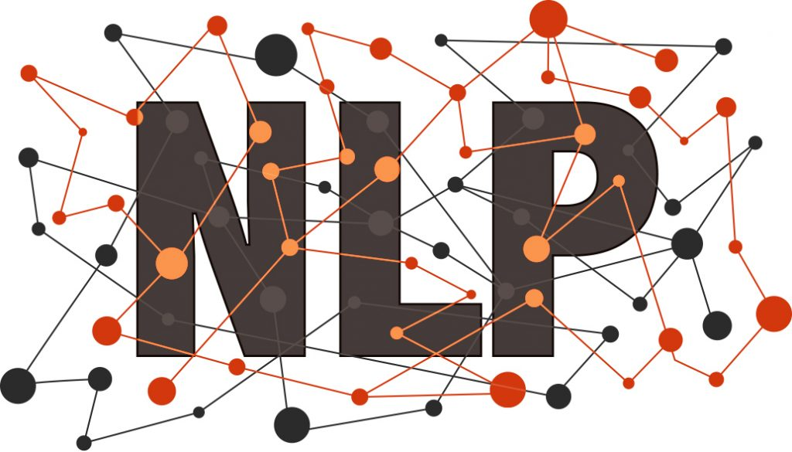

Slide 31
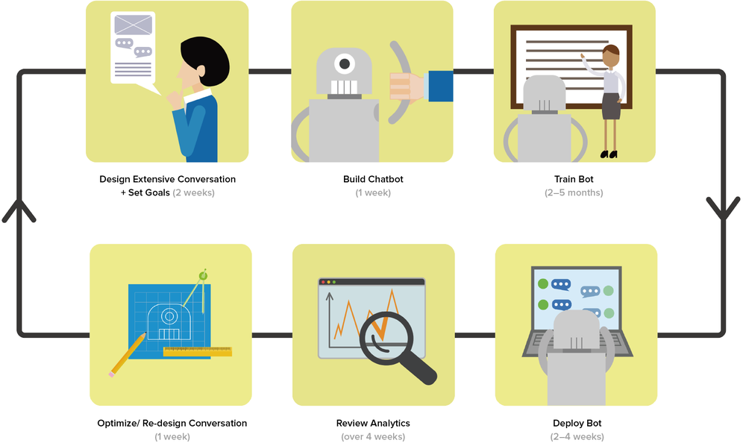
What is NLP
Natural language processing (NLP) is the ability of a computer program to understand human language as it is spoken or written

Slide 32
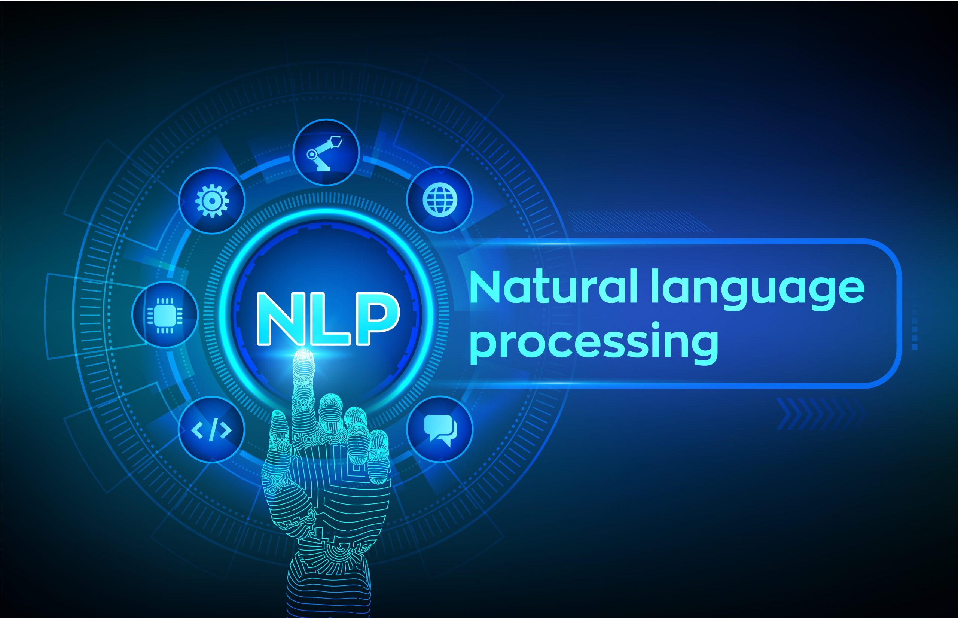
AI and NLP
AI: Demanding machine should come closer to human being
NLP: Computer being able to process human languages like English, Hindi
NLP is forcing function for AI

Slide 33
Motivation of Learning NLP?
Huge amount of data in internet – in form of texts (Natural Language)
Documents, Emails, Blogs, Social Media post =
Appications needed to process this huge amount of unstructured data

Slide 34
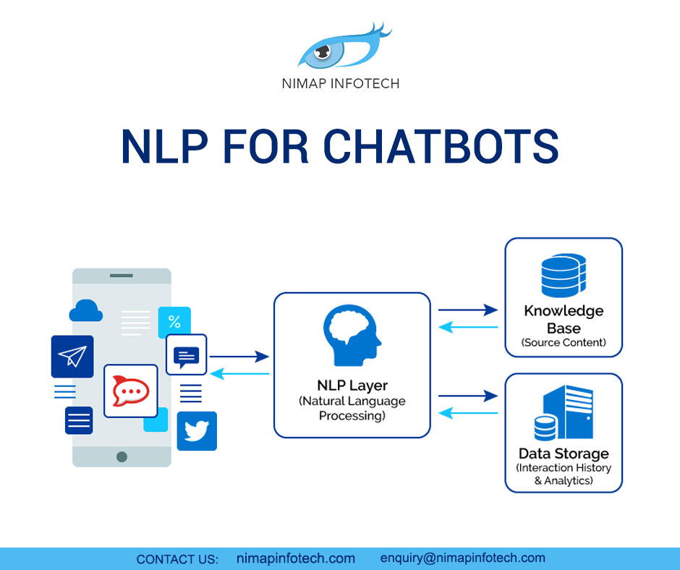
Chatbot NLP Architecture

Slide 35
How to implement NLP?
Notes:
Let’s hear it from you guys first. What do you think is cloud computing?

Slide 36
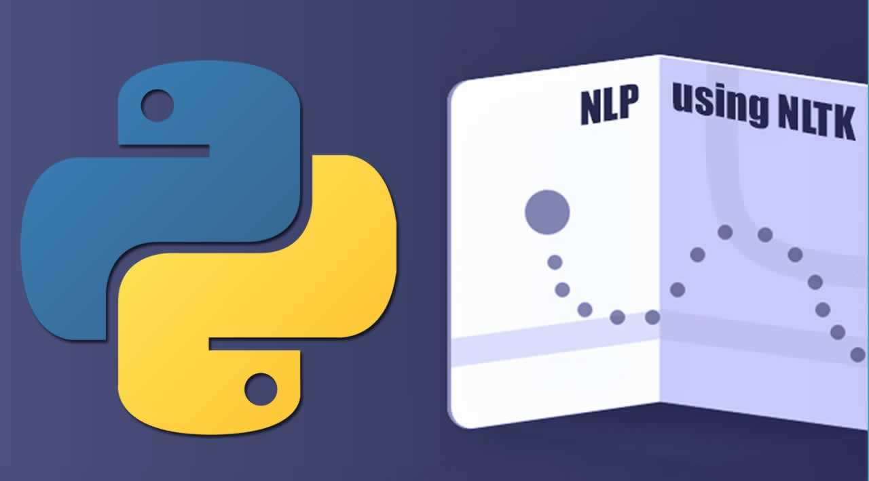
With Python

Slide 37
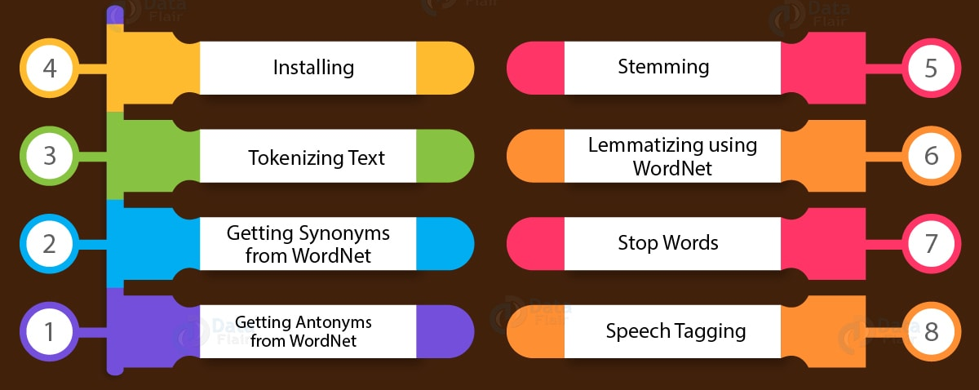
NLTK Library

Slide 38
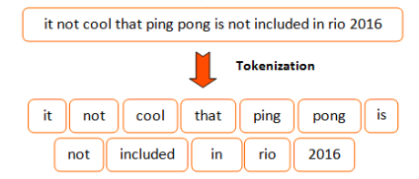
Tokenization

Slide 39
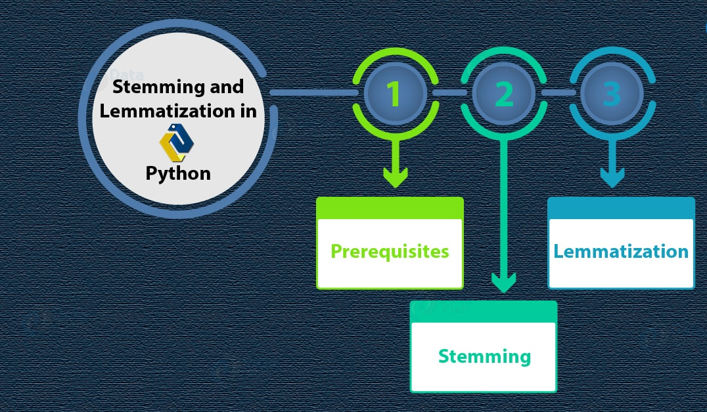

Slide 40
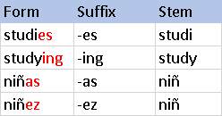
Stemming

Slide 41
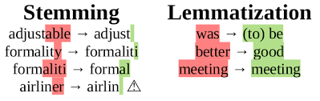
Lemmatization

Slide 42
Lets do some Hand On
Notes:
Let’s hear it from you guys first. What do you think is cloud computing?

Slide 43
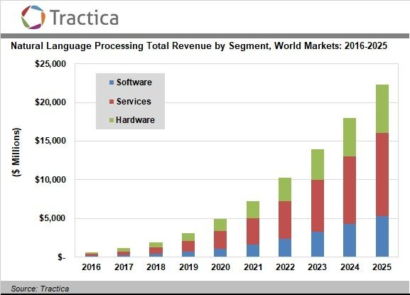
Future of NLP

Slide 44
Can we merge Distributed Networking with AI & NLP?
Notes:
Let’s hear it from you guys first. What do you think is cloud computing?

Slide 45
Think, Think
Notes:
Let’s hear it from you guys first. What do you think is cloud computing?

Slide 46
And again Think
Notes:
Let’s hear it from you guys first. What do you think is cloud computing?

Slide 47
Queries
Notes:
Let’s hear it from you guys first. What do you think is cloud computing?

Slide 48
Learning Resources
Head to Microsoft Learn:
https://docs.microsoft.com/en-us/learn/
Free Pluralsight Azure training
https://www.pluralsight.com/partners/microsoft/azure
LinkedIn Learning
https://www.linkedin.com/learning/topics/azure
Get your visual studio Dev Essentials benefits today!
Log on to https://my.visualstudio.com

Slide 49


Thank you for attending today’s session!
Soumyadip Chowdhury
Soumyadip.chowdhury@studentpartner.com
+91 7687028083
@s_oumyadip

Slide 50


